Slide 1
1. Introduction
The proposed system is a website for people to check if they are diabetic or not and create, check and view their diet plan based on the factors like their age, height, weight, food interest, BMI, food calorie count.
The aim of this project is to develop a system which can perform early prediction of diabetes for a patient with a higher accuracy by combining the results of different machine learning techniques.
Nutrition is the essential basis for health and development of human life from the earliest stage of fetal development into old age. Healthy food and proper nutrition are indubitable requirements for survival, physical development, mental growth, performance and productivity, health, and well-being
The accuracy of the model using each of the algorithms is calculated. Then the one with a good accuracy is taken as the model for predicting the diabetes.

Slide 2
2. Problem Statement
Diabetes is major cause of death in the world The present clinical practice consists in collecting the data necessary to detect diabetes through a number of tests and then providing an appropriate diagnostic drug. If diabetes can be discovered at the primary stage, harmful effects can be avoided with adequate medical care.
These days people have started to focus more on their health, so it is necessary to know what to eat and when to eat in a systematic manner to stay healthy. Our website will save people’s time to do all the search and give food recommendations for a healthy diet.
The aim of this project is to develop a system which can perform early prediction of diabetes for a patient with a higher accuracy and provide users a diet plan based on their interest by combining the results of different machine learning techniques.

Slide 3
6. Tools and Languages
Techniques
Data Pre-processing
Optimization
Tools and Services
Jupyter lab
Languages & Libraries
Deep Learning
Python
VS Code
PIMA Indian Diabetes dataset
Flask framework
CSS
HTML
Pandas
Matplotlib
Seaborn
Sklearn
Mlpclassifier
Neural networks
Graphs
numpy

Slide 4
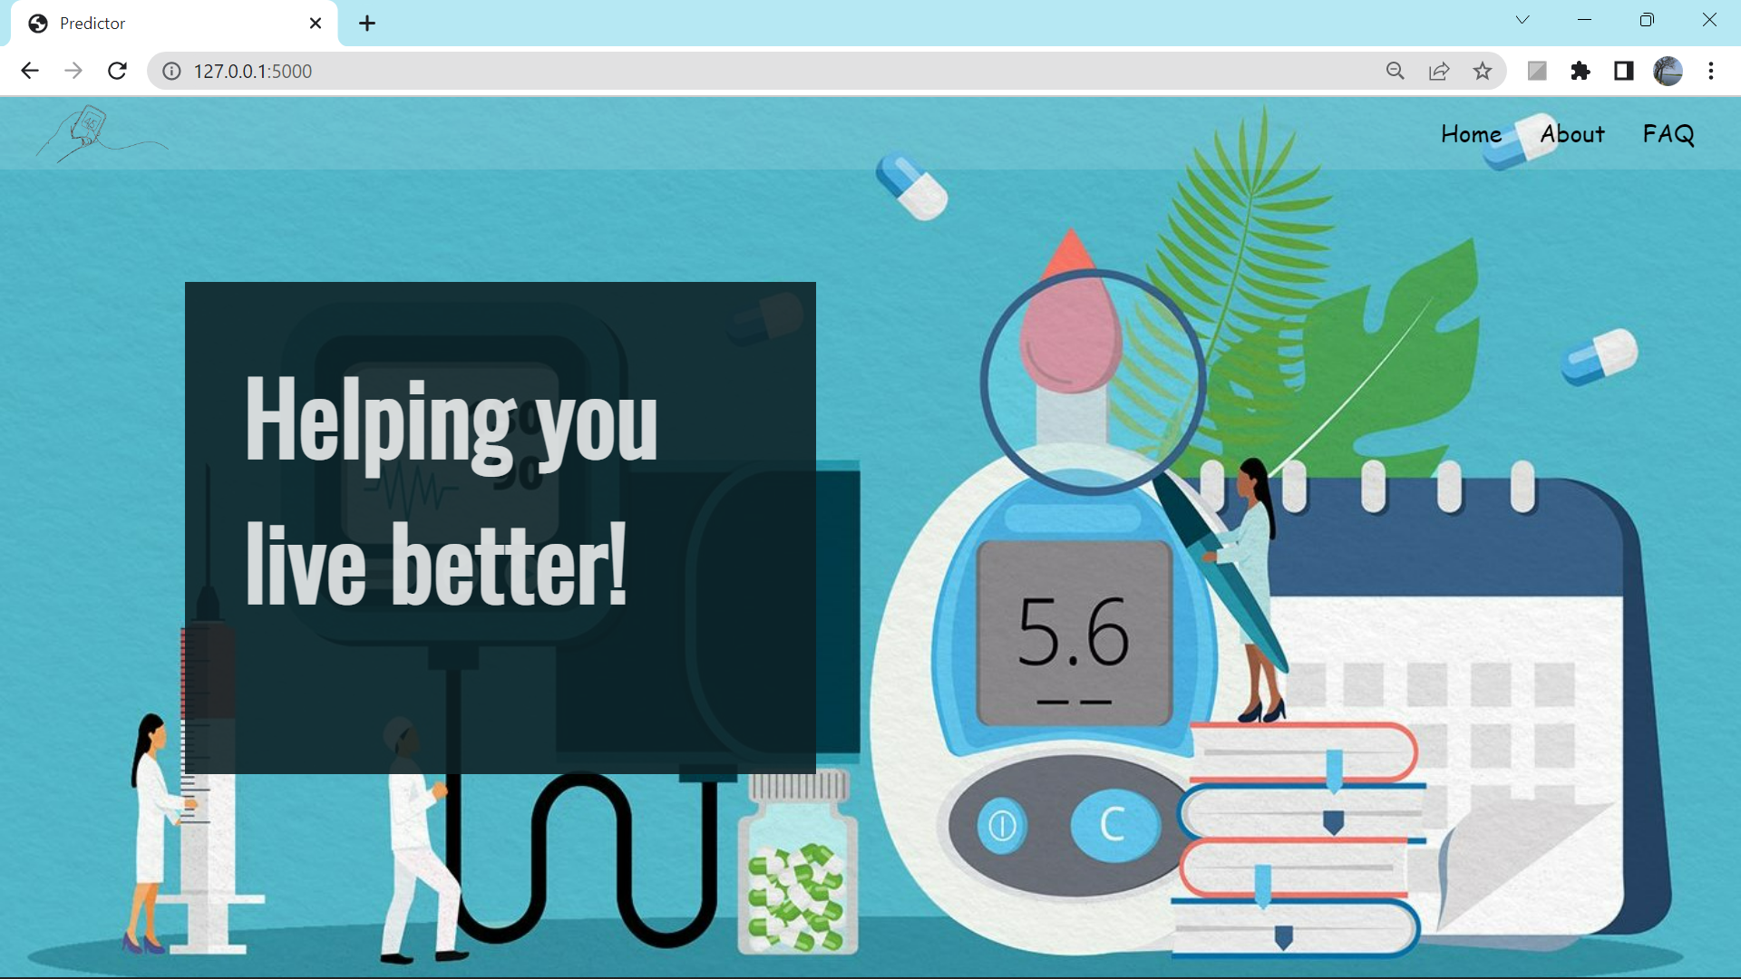
9. Results

Slide 5
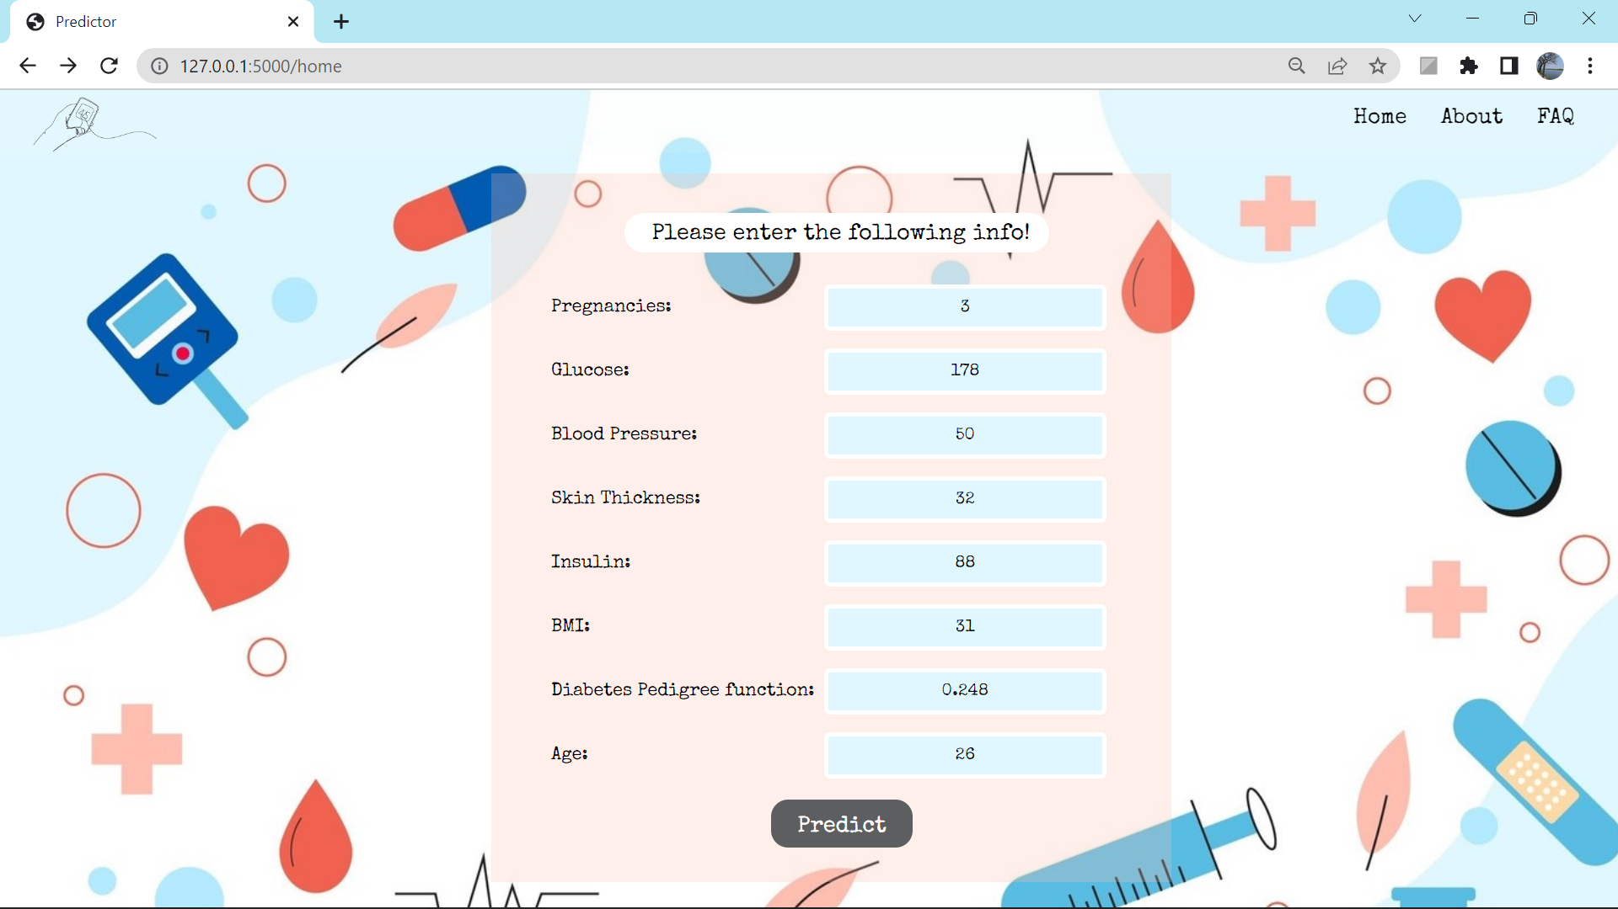
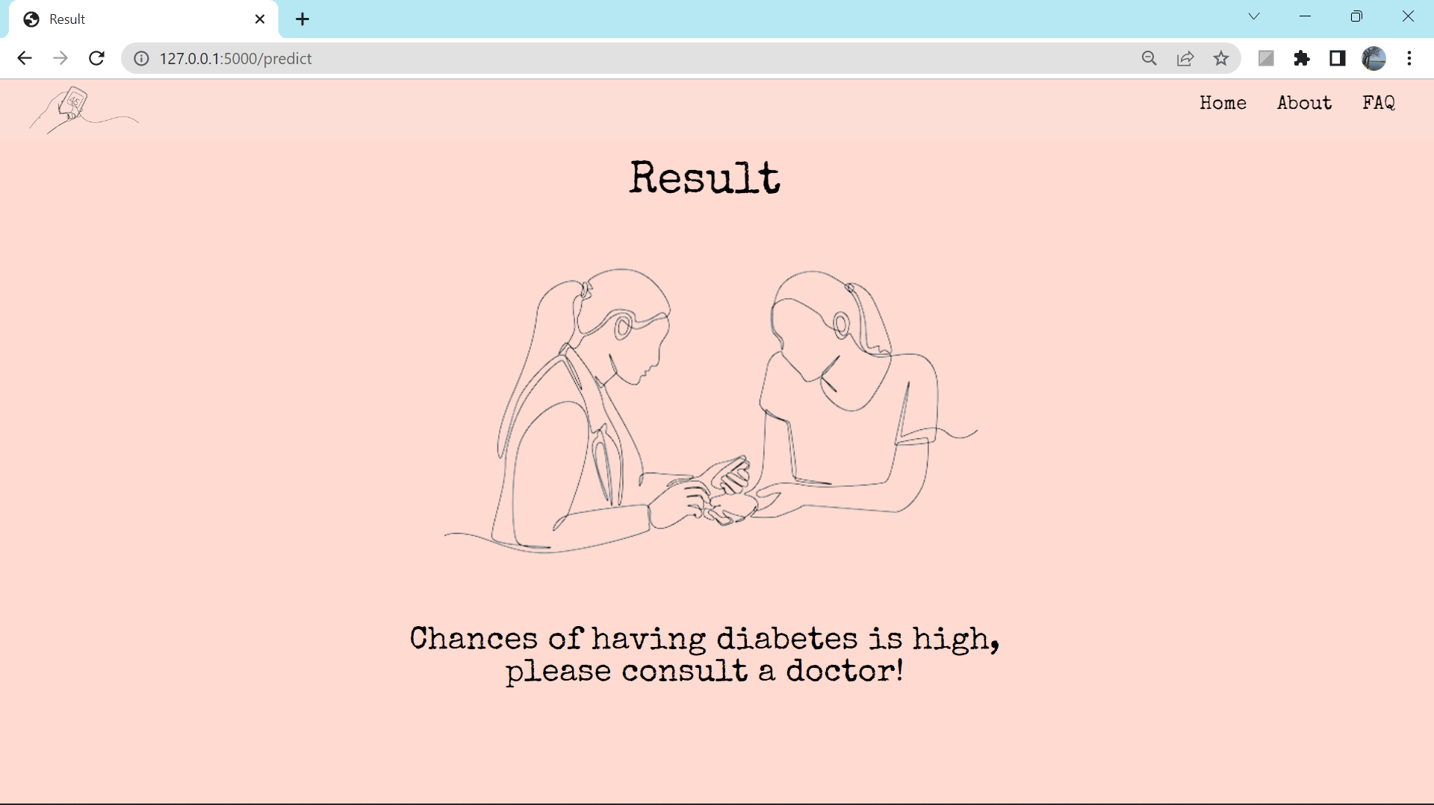
9. Results

Slide 6

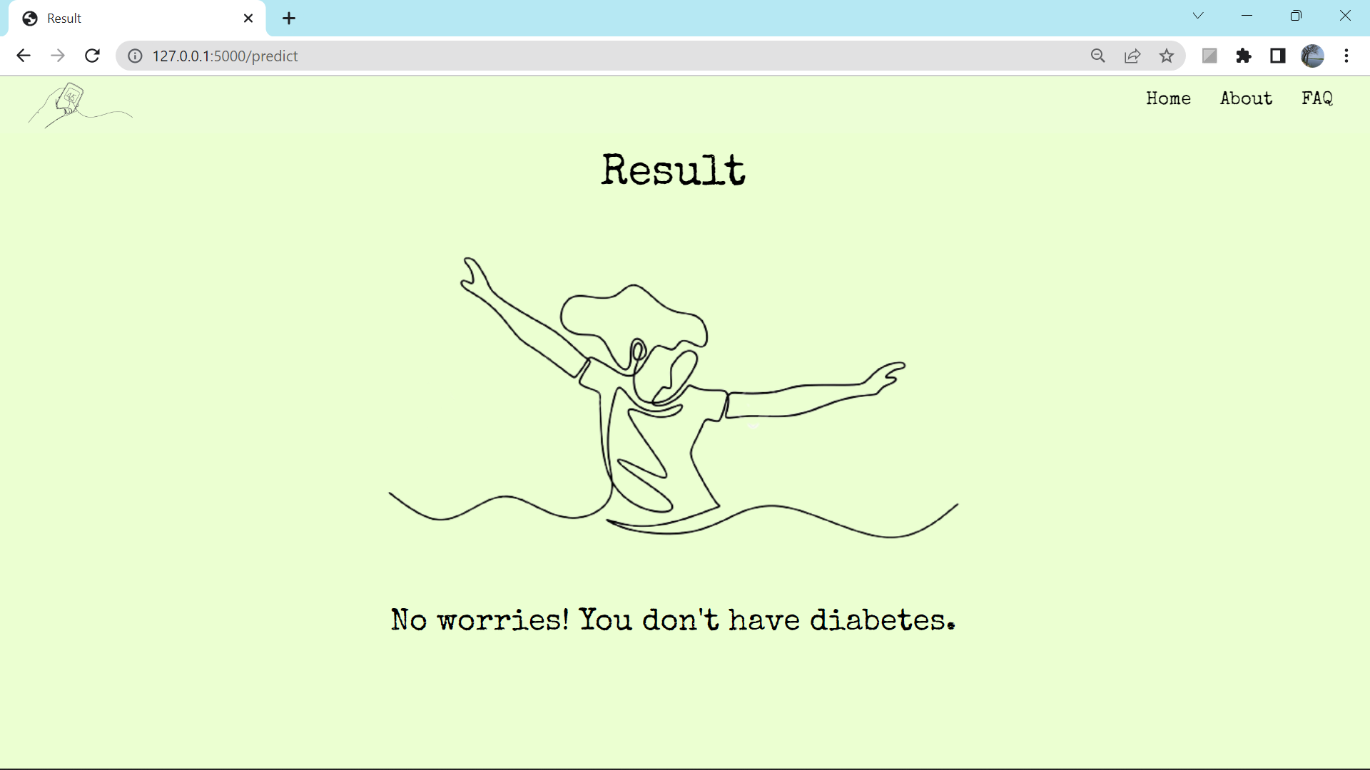
9. Results

Slide 7
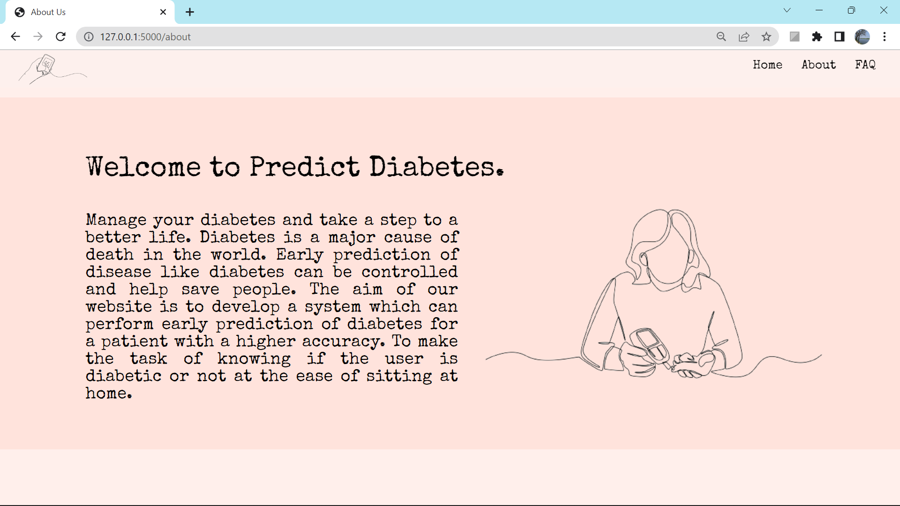
9. Results

Slide 8
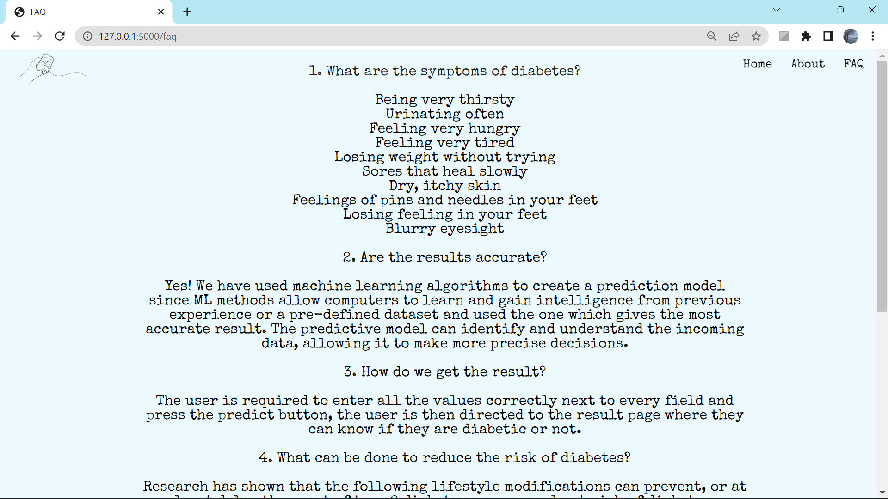
9. Results

Slide 9
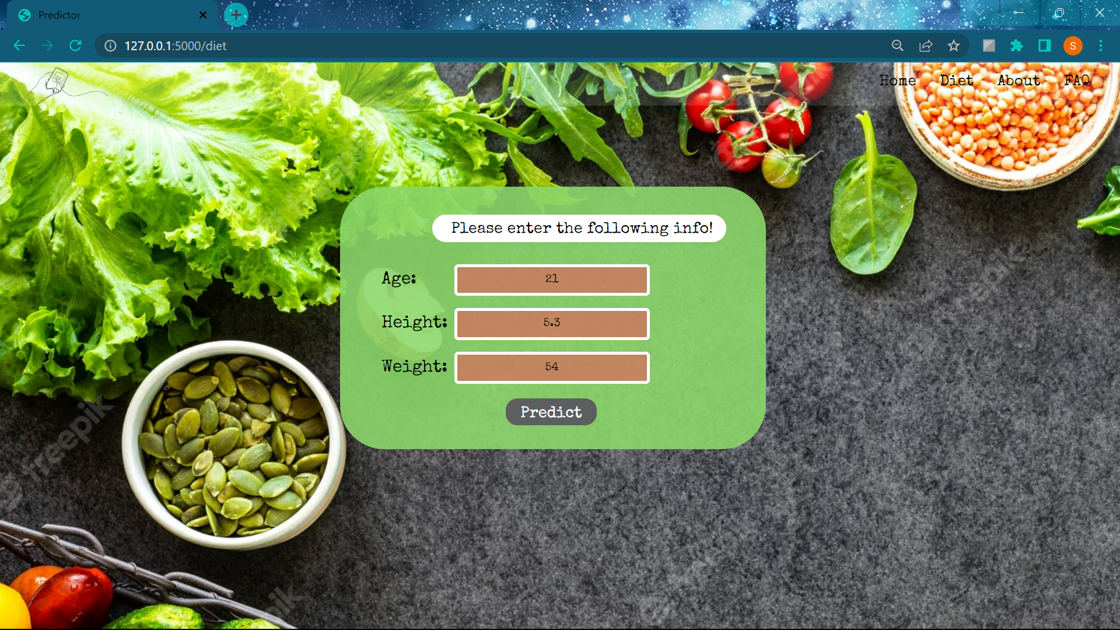
9. Results

Slide 10
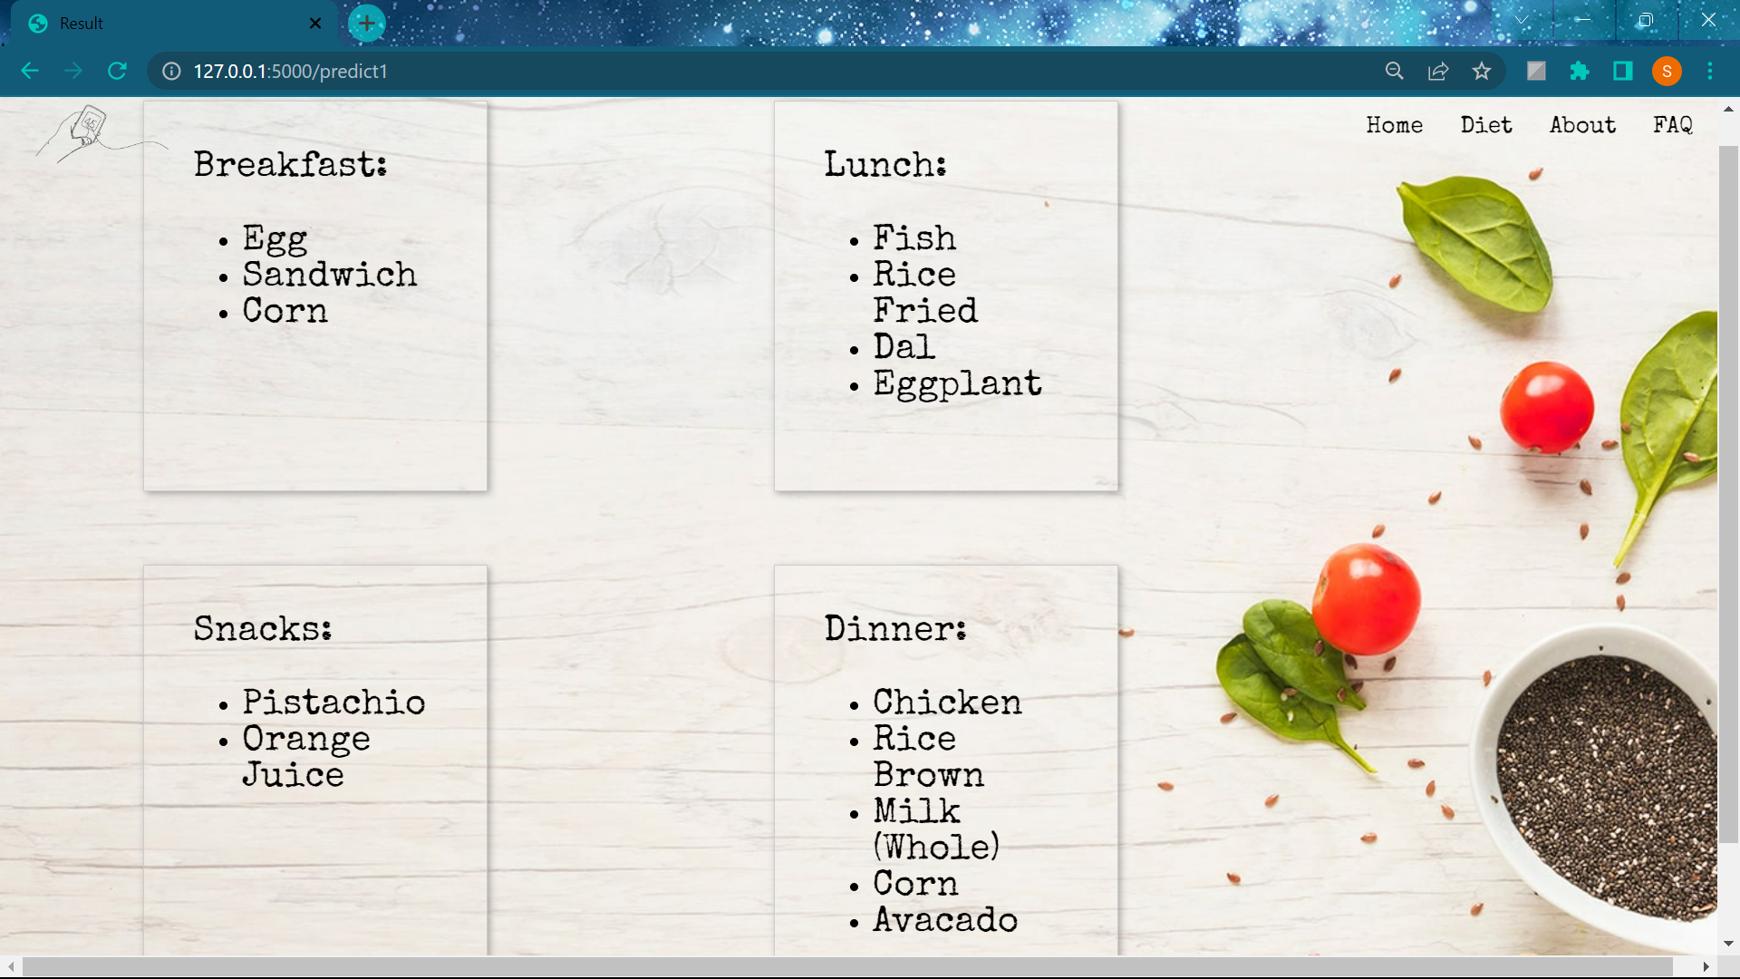
9. Results

